Slide 1
Interdependence and
the Gains from Trade
© 2012 Cengage Learning. All Rights Reserved. May not be copied, scanned, or duplicated, in whole or in part, except for use as permitted in a license distributed with a certain product or service or otherwise on a password-protected website for classroom use.

Slide 2
A Parable for the Modern Economy
Only two goods
  Meat
  Potatoes
Only two people
  Rancher
  Farmer
© 2012 Cengage Learning. All Rights Reserved. May not be copied, scanned, or duplicated, in whole or in part, except for use as permitted in a license distributed with a certain product or service or otherwise on a password-protected website for classroom use.

Slide 3
A Parable for the Modern Economy
If rancher produces only meat
  And farmer produces only potatoes
  Both gain from trade
If both rancher and farmer produce both meat and potatoes
  Both gain from specialization and trade
Production possibilities frontier
  Various mixes of output that an economy can produce
© 2012 Cengage Learning. All Rights Reserved. May not be copied, scanned, or duplicated, in whole or in part, except for use as permitted in a license distributed with a certain product or service or otherwise on a password-protected website for classroom use.

Slide 4
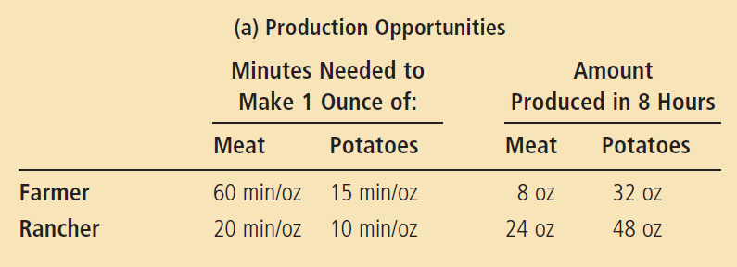
Figure 1
The Production Possibilities Frontier (a)
Panel (a) shows the production opportunities available to the farmer and the rancher.
© 2012 Cengage Learning. All Rights Reserved. May not be copied, scanned, or duplicated, in whole or in part, except for use as permitted in a license distributed with a certain product or service or otherwise on a password-protected website for classroom use.

Slide 5
Figure 1
The Production Possibilities Frontier (b, c)
(b) The farmer’s production
possibilities frontier
(c) The rancher’s production
possibilities frontier
Meat (oz)
Meat (oz)
If there is no trade, the farmer chooses this production and consumption.
If there is no trade, the rancher chooses this production and consumption.
24
8
12
B
4
A
0
16
32
0
24
48
Potatoes (oz)
Potatoes (oz)
Panel (b) shows the combinations of meat and potatoes that the farmer can produce. Panel (c) shows the combinations of meat and potatoes that the rancher can produce. Both production possibilities frontiers are derived assuming that the farmer and rancher each work 8 hours per day. If there is no trade, each person’s production possibilities frontier is also his or her consumption possibilities frontier.
© 2012 Cengage Learning. All Rights Reserved. May not be copied, scanned, or duplicated, in whole or in part, except for use as permitted in a license distributed with a certain product or service or otherwise on a password-protected website for classroom use.

Slide 6
A Parable for the Modern Economy
Specialization and trade
  Farmer – specialize in growing potatoes
    More time growing potatoes
    Less time raising cattle
  Rancher – specialize in raising cattle
    More time raising cattle
    Less time growing potatoes
  Trade: 5 oz of meat for 15 oz of potatoes
  Both gain from specialization and trade
© 2012 Cengage Learning. All Rights Reserved. May not be copied, scanned, or duplicated, in whole or in part, except for use as permitted in a license distributed with a certain product or service or otherwise on a password-protected website for classroom use.

Slide 7
Figure 2
How Trade Expands the Set of Consumption Opportunities (a, b)
(a) The farmer’s production
and consumption
(b) The rancher’s production
and consumption
Meat (oz)
Meat (oz)
Farmer's production and consumption without trade
Rancher’s production with trade
Rancher’s production and consumption without trade
24
Farmer's consumption with trade
18
8
Rancher’s consumption with trade
13
B*
A*
12
5
Farmer's production with trade
B
4
A
0
16
17
32
0
12
24
27
48
Potatoes (oz)
Potatoes (oz)
The proposed trade between the farmer and the rancher offers each of them a combination of meat and potatoes that would be impossible in the absence of trade. In panel (a), the farmer gets to consume at point A* rather than point A. In panel (b), the rancher gets to consume at point B* rather than point B. Trade allows each to consume more meat and more potatoes.
© 2012 Cengage Learning. All Rights Reserved. May not be copied, scanned, or duplicated, in whole or in part, except for use as permitted in a license distributed with a certain product or service or otherwise on a password-protected website for classroom use.

Slide 8
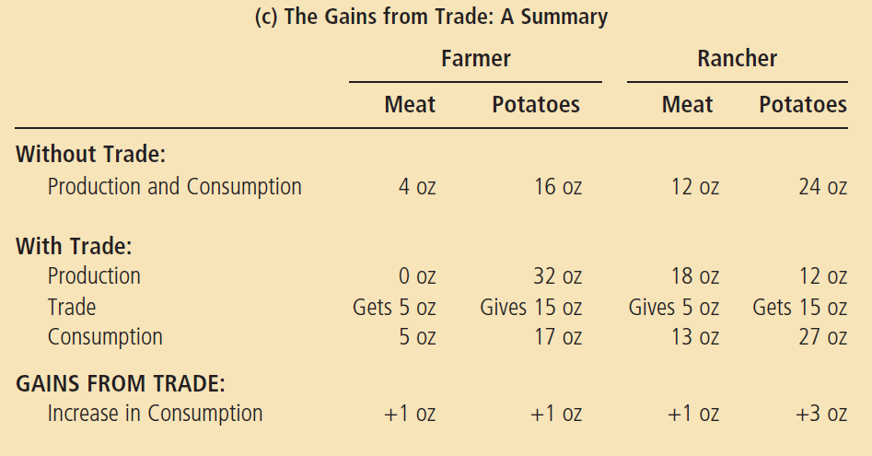
Figure 2
How Trade Expands the Set of Consumption Opportunities (c)
The proposed trade between the farmer and the rancher offers each of them a combination of meat and potatoes that would be impossible in the absence of trade. In panel (a), the farmer gets to consume at point A* rather than point A. In panel (b), the rancher gets to consume at point B* rather than point B. Trade allows each to consume more meat and more potatoes.
© 2012 Cengage Learning. All Rights Reserved. May not be copied, scanned, or duplicated, in whole or in part, except for use as permitted in a license distributed with a certain product or service or otherwise on a password-protected website for classroom use.

Slide 9
Comparative Advantage
Absolute advantage
  Produce a good using fewer inputs than another producer
Opportunity cost
  Whatever must be given up to obtain some item
  Measures the trade-off between the two goods that each producer faces
© 2012 Cengage Learning. All Rights Reserved. May not be copied, scanned, or duplicated, in whole or in part, except for use as permitted in a license distributed with a certain product or service or otherwise on a password-protected website for classroom use.

Slide 10
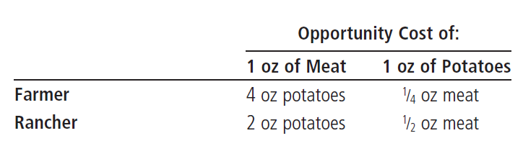
Table 1
The Opportunity Cost of Meat and Potatoes
© 2012 Cengage Learning. All Rights Reserved. May not be copied, scanned, or duplicated, in whole or in part, except for use as permitted in a license distributed with a certain product or service or otherwise on a password-protected website for classroom use.

Slide 11
Comparative Advantage
Comparative advantage
  Produce a good at a lower opportunity cost than another producer
  Reflects the relative opportunity cost
Principle of comparative advantage
  Each good - produced by the individual that has the smaller opportunity cost of producing that good
© 2012 Cengage Learning. All Rights Reserved. May not be copied, scanned, or duplicated, in whole or in part, except for use as permitted in a license distributed with a certain product or service or otherwise on a password-protected website for classroom use.

Slide 12
Comparative Advantage
One person
  Can have absolute advantage in both goods
  Cannot have comparative advantage in both goods
For different opportunity costs
  One person - comparative advantage in one good
  The other person - comparative advantage in the other good
© 2012 Cengage Learning. All Rights Reserved. May not be copied, scanned, or duplicated, in whole or in part, except for use as permitted in a license distributed with a certain product or service or otherwise on a password-protected website for classroom use.

Slide 13
Comparative Advantage
Opportunity cost of one good
  Inverse of the opportunity cost of the other
Gains from specialization and trade
  Based on comparative advantage
  Total production in economy rises
    Increase in the size of the economic pie
    Everyone – better off
© 2012 Cengage Learning. All Rights Reserved. May not be copied, scanned, or duplicated, in whole or in part, except for use as permitted in a license distributed with a certain product or service or otherwise on a password-protected website for classroom use.

Slide 14
Comparative Advantage
Trade can benefit everyone in society
  Allows people to specialize
The price of trade
  Must lie between the two opportunity costs
Principle of comparative advantage explains:
  Interdependence
  Gains from trade
© 2012 Cengage Learning. All Rights Reserved. May not be copied, scanned, or duplicated, in whole or in part, except for use as permitted in a license distributed with a certain product or service or otherwise on a password-protected website for classroom use.

Slide 15
Applications of Comparative Advantage
Should Tom Brady Mow His Own Lawn?
Brady, in 2 hours
  Mow his lawn, or
  Film a TV commercial, earn $20,000
Forest Gump, in 4 hours
  Mow Brady’s lawn
  Work at McDonald’s, earn $40
© 2012 Cengage Learning. All Rights Reserved. May not be copied, scanned, or duplicated, in whole or in part, except for use as permitted in a license distributed with a certain product or service or otherwise on a password-protected website for classroom use.

Slide 16
Applications of Comparative Advantage
Should the U.S. trade with other countries?
Imports
  Goods produced abroad and sold domestically
Exports
  Goods produced domestically and sold abroad
© 2012 Cengage Learning. All Rights Reserved. May not be copied, scanned, or duplicated, in whole or in part, except for use as permitted in a license distributed with a certain product or service or otherwise on a password-protected website for classroom use.

Slide 17
Applications of Comparative Advantage
Should the U.S. trade with other countries?
  U.S and Japan
    Each produces food and cars
    One American worker, one month
      One car, or
      Two tons of food
    One Japanese worker, one month
      One car
      One ton of food
© 2012 Cengage Learning. All Rights Reserved. May not be copied, scanned, or duplicated, in whole or in part, except for use as permitted in a license distributed with a certain product or service or otherwise on a password-protected website for classroom use.

Slide 18
Applications of Comparative Advantage
Principle of comparative advantage
  Each good – produced by the country with the smaller opportunity cost of producing that good
Specialization and trade
  All countries have more food and more cars
© 2012 Cengage Learning. All Rights Reserved. May not be copied, scanned, or duplicated, in whole or in part, except for use as permitted in a license distributed with a certain product or service or otherwise on a password-protected website for classroom use.

